Slide 1
The Early Hebrews
Ch. 7, Section 1

Slide 2
Key Terms and People
Judaism – the Hebrew religion
Abraham – God told him to leave his home and go on a long journey west. God promised to lead Abraham to a new land and make his descendants into a mighty nation.
Moses – God told this man to lead the Hebrews out of Egypt during the 1200s BC.
Exodus – the journey of Moses leading his people out of Egypt.

Slide 3
Abraham: Man of God
Abraham left Mesopotamia because God promised him land and to make his descendants a nation.
He settled in Canaan, on the Mediterranean Sea.
Later, however, some Hebrews moved to Egypt because of a famine.

Slide 4
Hebrews in Egypt
While the Hebrews were living in Egypt, their population continued to increase.
The pharaoh feared that the Hebrews would take over Egypt.
He decided to enslave them to prevent this.

Slide 5
The Exodus
According to the Bible, a leader named Moses appeared among the Hebrew people.
In the 1200s BC, Moses demanded that the Pharaoh release the Hebrew people.
When the Pharaoh refused, a series of plagues struck Egypt.
Because of this, the pharaoh released the Hebrews. Moses led them out of Egypt in the Exodus.

Slide 6
Wandering
For many years after the Exodus, the Hebrews wandered 40 years through the desert trying to reach Canaan.
They eventually reached a mountain called Sinai. On this mountain, God gave Moses the 10 Commandments.
The 10 Commandments were a set of moral codes in which the Hebrews agreed to value human life, self-control, and justice.

Slide 7
Return to Canaan
Moses died before being allowed to enter Canaan.
Once there, the Hebrews had to battle the people living in Canaan.
After conquering the Canaanites, they settled down and became known as the Israelites.

Slide 8
Kings Unite the Israelites
The Philistines invaded Israelites lands in mid-1000s BC.
Frightened by these powerful invaders, the Israelites banded together under a single leader named Saul.
Saul was the first king of Israel; he was a strong military leader, but not a strong king. Most of the religious leaders did not agree with him.

Slide 9
King David
After Saul died, David became king.
He had once been a servant for king Saul. David became close to Saul’s family, but Saul distrusted him and declared him an outlaw.
David lived in the desert for many years, slowly gaining the support of local people.
David was well loved by his people. He defeated the Philistines along with many other war victories. He also captured Jerusalem, which would eventually become Israel’s capital.

Slide 10
King Solomon
David’s son Solomon took the throne in 965 BC. He was a strong king like his father.
He expanded the kingdom into other lands. Egypt and Phoenicia became his allies.
Solomon built one of the greatest temples on earth in Jerusalem and dedicated it to God.
Solomon’s Temple was the religious center for the Israelites.

Slide 11
Invaders Conquer and Rule
After Solomon’s death in 930 BC, revolts broke out about who would be king.
Within a year, Israel was torn apart. Israel split into two kingdoms: Israel and Judah.
The two new kingdoms lasted for many centuries. In the end, however, they were defeated.
The Assyrians defeated Israel in 722 BC. Most of the people scattered.
Judah was defeated by the Chaldeans.

Slide 12
Diaspora
The Diaspora is the spreading of the Jewish people after Israel and Judah were taken over
Rome defeats the invaders. After it becomes safe to return, many Jewish people chose not to, spreading their culture and descendants all over the Persian Empire

Slide 13
Independence and Conquest
160 BC—A Jewish family called the Maccabees led a revolt and allowed the Jews to run their kingdom for another 100 years
63 BC—Romans conquer the Jews
Jewish were not happy with Roman rule and talk of revolt

Slide 14
Women in Hebrew Culture
Woman’s father picked her husband
Women had no rights
They could only inherit their parent’s land/home if they had no brothers
If a woman’s husband died, she had to marry one of his brothers
If he had no brothers, she was poor and had little to take care of herself
Important Hebrew Women
Queen Esther
Deborah the Judge
Ruth the widow (set example of how virtuous Hebrew women acted)

Slide 15
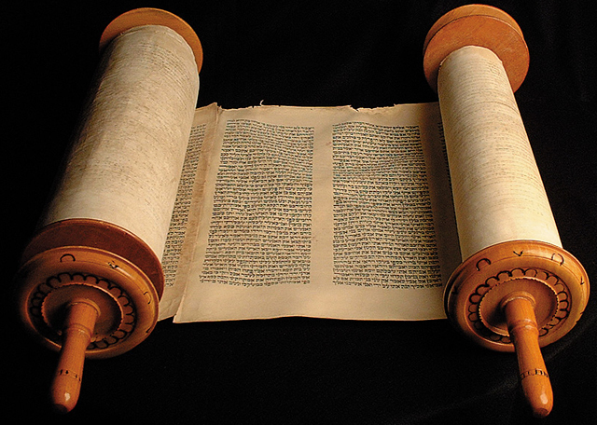
Jewish Beliefs and Texts
Ch. 7, Sec. 2

Slide 16
Belief in One God
The Jewish faith is monotheistic
The Hebrew name for God is Yahweh
Monotheism – the belief in only one god. The Jews only believed in one God.
Possibly the world’s first monotheistic religion

Slide 17
Belief in Justice and Righteousness
Justice=kindness and fairness when dealing with people
Believe in giving aid to the poor, sick, and orphans
Expect fair dealings in business

Slide 18
Belief in Obedience of Law
Most important laws= 10 Commandments
The Mosaic Laws--a system of laws that the Jews believed came from Yahweh.
like the Ten Commandments because they guide the Jews on how to live their daily lives (how to pray, celebrate holidays, observance of Sabbath day)

Slide 19
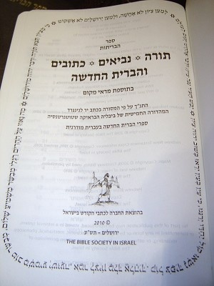
Jewish Texts
Tanach—the Hebrew Bible is made up of 3 parts:
Torah
8 books of the Prophets
11 books of Poetry, Songs, Stories, Lessons and History
Torah – the most sacred text of Judaism.
The contents of the Torah were revealed to Moses
First 5 books of the Christian Bible

Slide 20
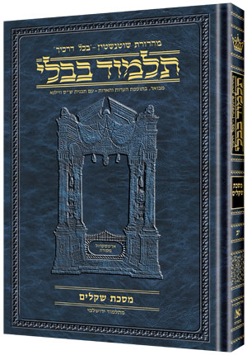
Talmud—set of commentaries, stories, and folklore about the Hebrew people
Highly important to the Hebrew people

Slide 21
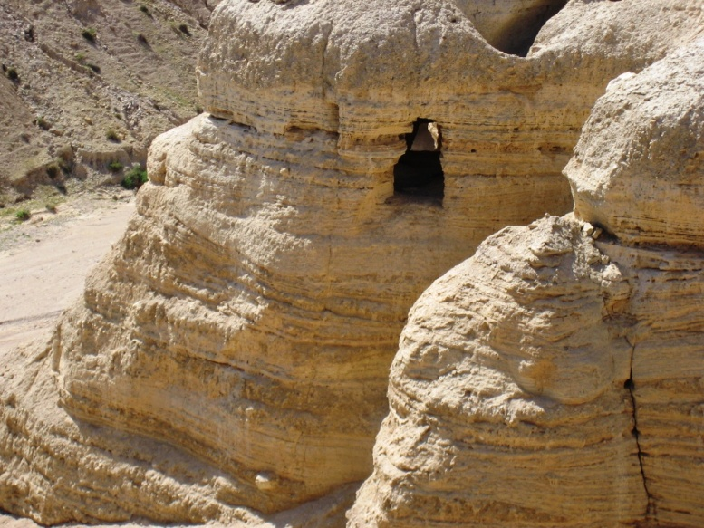
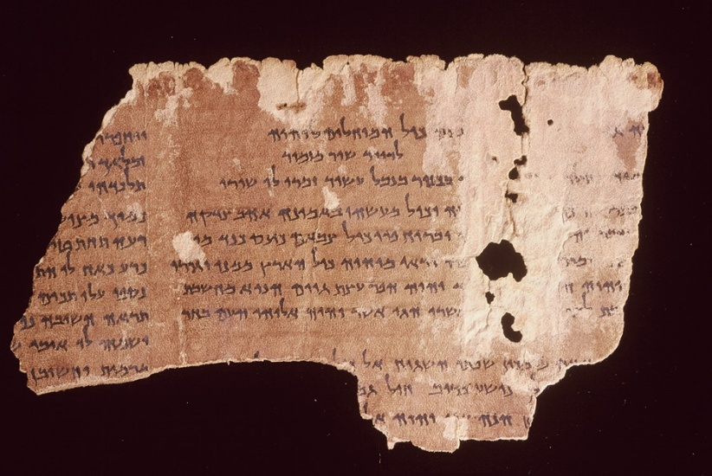
Dead Sea Scrolls – written 2000 years ago by Jews to explain ancient Jewish beliefs. They were found by a young boy exploring a small cave near the Dead Sea.

Slide 22
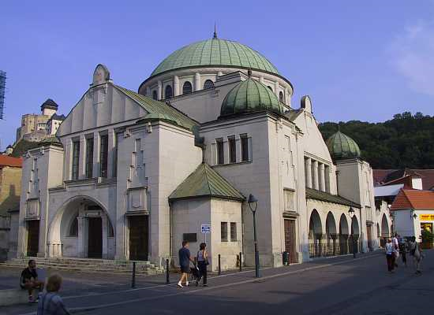
Synagogue – Jewish house of worship
Prophet – people who are said to receive messages from God to be taught to others.

Slide 23
Judaism Influences Later Cultures
Judaism has greatly influenced European and American cultures
Many people look to the 10 Commandments on how to live their life righteously
Many businesses observe Sabbath by not opening/opening at 1:00 on Sundays
Shaped Christianity
Jesus was born Jewish; Christians believe Jesus fulfilled the Jewish prophecy of the Christ Savior
Shaped Islam
First people to adopt Islam believe that they are descendants of Abraham, like Hebrews

Slide 24
Judaism over the Centuries
Ch. 7, Sec. 3

Slide 25
Revolt against Rome
Rome took over Israel
Zealots—led many revolts against Rome
Believed that Jews should only have to answer to God, not foreign rule
AD 66—Jews revolted against Roman rule, led by Zealots
Not successful
Romans destroyed Jerusalem and burned the Second Temple (built after King Solomon’s Temple was destroyed earlier) as punishment
Losing the Second Temple made most Jews give up
1,000 Zealots refused to give up; locked themselves in a mountain fortress
15,000 Roman soldiers attacked the fortress for 2 years and finally broke in; Zealots committed suicide so they wouldn’t be made into slaves

Slide 26
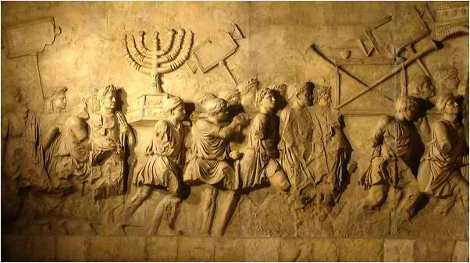
Results of the Revolt
Romans killed most of Jerusalem’s people
Those who were not killed were turned into slaves
Jews tried to revolt 60 years later, but that was unsuccessful as well

Slide 27
Migration and Discrimination
Because the Second Temple was destroyed, local synagogues became important places of worship
Rabbis, Jewish religious leaders, took on important leadership roles, helping Jews in their religious lives
Taught and interpreted the Torah
Jewish people migrated all over the Mediterranean area
Many groups they came into contact with mistreated them and discriminated against them

Slide 28
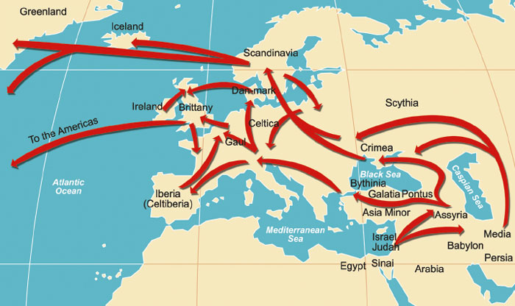
Jewish Migration, AD 70 and after

Slide 29
Cultural Traditions after Migration
ALL Jews still believed in Yahweh and followed the sacred texts
Languages, rituals, and cultures of the dispersed Jews began to evolve
Eastern European Jews
Usually separated themselves from non-Jews
Created the Yiddish language, similar to German but written in Hebrew alphabet
Spanish and Portuguese Jews
Interacted with non-Jews
Created the Ladino language, mix of Spanish, Hebrew, and Arabic
Their scholars made advances in mathematics, astronomy, medicine, and philosophy

Slide 30
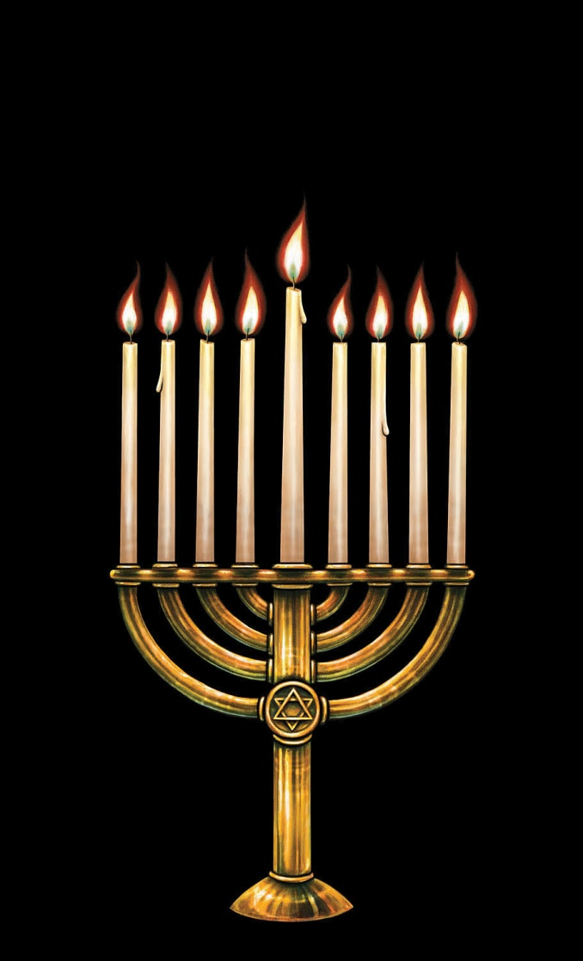
Traditions and Holy Days
Hanukkah
In December
Honors the rededication of the Second Temple by the Maccabee family
According to legend, the Maccabee family had convinced non-Jewish leaders to let them keep their religion (before Roman rule). They didn’t have enough lamp oil to burn for ceremony; the oil that should have lasted 1 day lasted 8 (a miracle from God)
Jews use a menorah, or special candle holder, to celebrate this

Slide 31
Passover
Passover
Celebrated in March or April
Time to remember the Exodus from Egypt
According to tradition, Jews only eat unleaven bread because bakers in Egypt didn’t have time for the bread to rise before they left
Eat seder, a meal that reflects symbolic parts of the Exodus

Slide 32
High Holy Days
These are the most important Jewish holidays
Take place in Sept. and Oct.
Rosh Hashanah (Beginning Jewish calendar)
Yom Kippur (Jews ask God for forgiveness; it is the holiest day of the entire year; fast all day)

Slide 33
Chapter Review
Pg. 220 reading and questions
Pg. 221, #1-10
What are the basic beliefs of Judaism?
What are some Jewish beliefs that we see around us today in the Western world (America & Europe)?
How did the Romans punish the Jewish people who revolted?
Pg. 223, #1-7

Slide 34
Judaism Project
You must do 2 things for your project:
1. Create a map
2. Choose a story from the following list to read and summarize. After summarizing the story, you must right an explanation of how this story illustrates an idea you learned in this chapter.

Slide 35
Map Assignment
On the paper provided, write your name in the upper right corner.
Title the map “Ancient Hebrews and Their Lands”
Color bodies of water blue
Color land orange
Trace and label Abraham’s route (p. 203 in book) in red
Trace and label Moses’ route (p. 203) in green
Label the Mediterranean Sea, the Euphrates River, the Red Sea, the Jordan River, Mount Sinai, Mesopotamia, Hittite Empire, Assyria
Label Ur and Babylon and mark them with a dot (b/c they are cities)
Create a key for your map

Slide 36
Story Choices—Pick one story to read and explain how it is related to something you learned in the chapter.
Genesis Ch. 12:1-3; and all of Ch. 15.
Exodus Ch. 12:1-16, 12:23-24
Exodus Ch.14:15-23, 14:30-31
Exodus Ch. 20
The book of Ruth
1 Samuel Ch. 18:13-16, 2 Samuel Ch. 3:1
1 King Ch. 3:5-14
1 King Ch. 5

